Slide 1
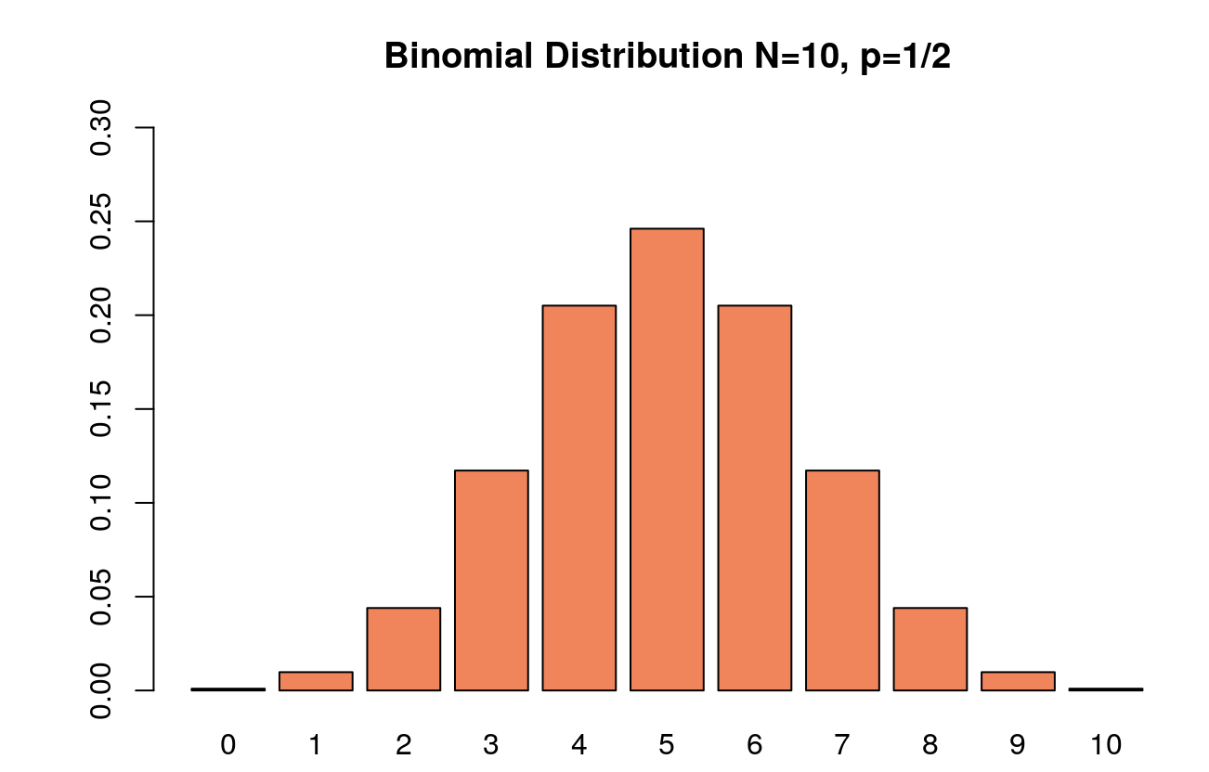
BIONOMIAL DISTRIBUTION
Name: Subhalaxmi Rout Date: 03/11/2020

Slide 2
Binomial Distribution
What is binomial distribution?
The binomial distribution is used to describe the number of successes/failure in a fixed number of trials.
For example: a coin toss has only two possible outcomes: heads or tails and taking a test could have two possible outcomes: pass or fail.

Slide 3
Binomial Distribution
Binomial experiment has following characteristics:
The process consist of a sequence of n trails
Only 2 exclusive outcomes are possible in one trial. One outcome is called “success” and other is called “failure”.
The probability of success is denoted by “p” and doesn’t change from trail to trail. The probability of failure is donated by “1 - p” and this is also fixed from trail to trail.
The trails are independent; the outcomes of previous trails to not influence future trails.

Slide 4
Binomial Distribution
General Formula for Binomial Distribution:
C(n, x) p^{x} (1- p)^{(n – x)}
^{n = number of trails} C(n, x) = n! / (n-x)! * (x)!
^{x = number of successes}
p = probability of success in any trail
1 – p = probability of failure in any trail

Slide 5
Binomial Distribution
Problem:
As a sales manager you analyze the sales record for all salesperson under your guidance.
Jack has a success rate of 75% and averages 10 sales calls per day. Nancy has a success rate of 45% and averages 16 calls per day.
What is the probability that each salesperson makes 6 sales on any given day?

Slide 6
Binomial Distribution
Solution:
Let’s talk about Jack.
n = 10 ; x = 6 ; p = 0.75
C(n, x) p^{x} (1- p)^{(n – x)}
C(10, 6) * (0.75) ⁶ * (1 – 0.75) ^{(10 – 6)}
C(10, 6) * (0.75) ⁶ * (0.25) ⁽⁴⁾
(210) * (0.1779785) * (0.00390625)
0.145998 ~ 14.6 %

Slide 7
Binomial Distribution
Solution:
Similarly for Nancy.
n = 16 ; x = 6 ; p = 0.45
C(n, x) p^{x} (1- p)^{(n – x)}
C(16, 6) * (0.45) ⁶ * (1 – 0.45) ^{(16 – 6)}
C(16, 6) * (0.45) ⁶ * (0.55) ⁽¹⁰⁾
(8008) * (0. 008303766) * (0. 002532952)
0. 1684326 ~ 16.8 %

Slide 8
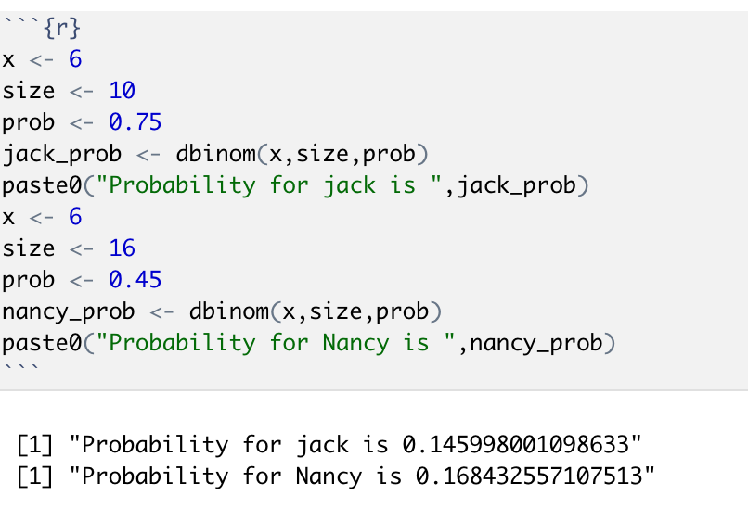
Binomial Distribution
Using R:

Slide 9
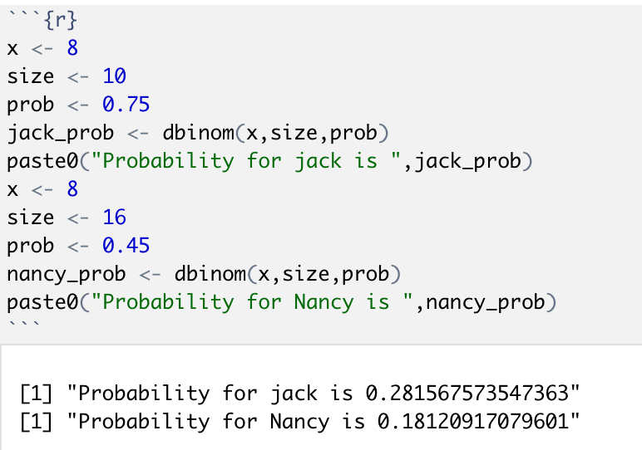
Binomial Distribution
Using R: Let x = 8 (each person make 8 sales on any given day)

Slide 10
Binomial Distribution
Using R: x = 8
Using R: x = 6

Slide 11
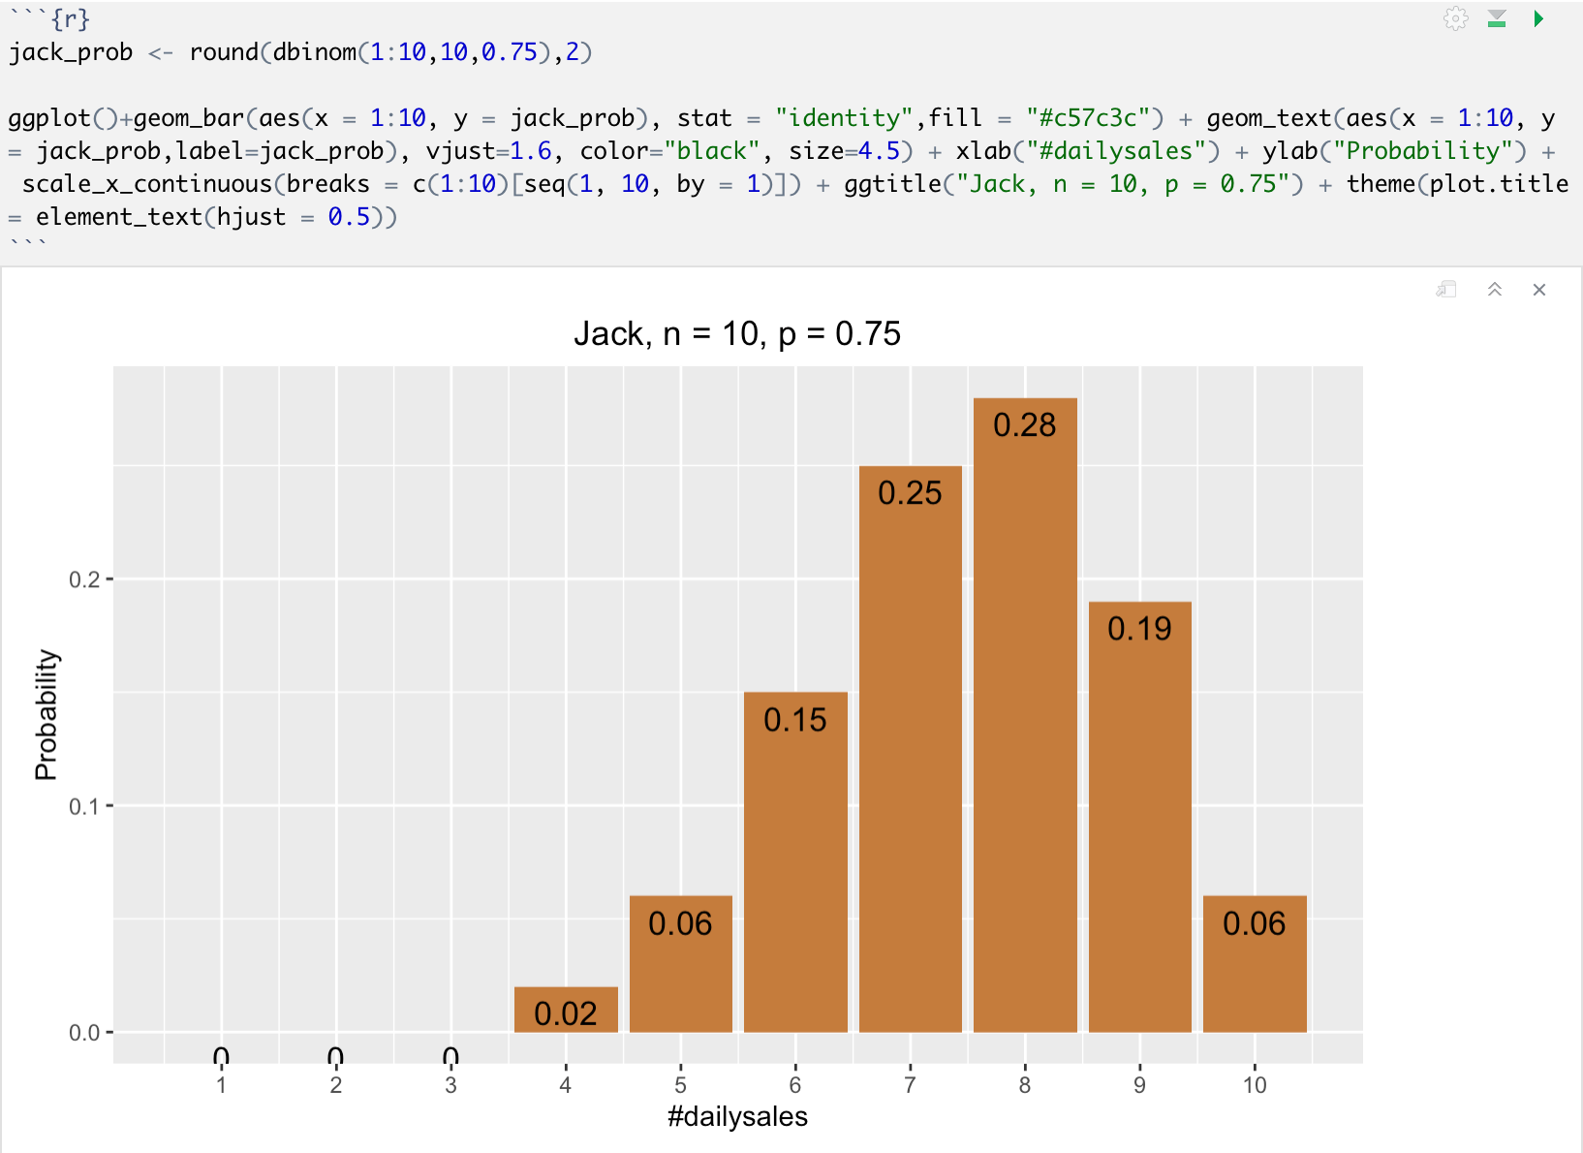
Binomial Distribution
Probability distribution graph for Jack:

Slide 12
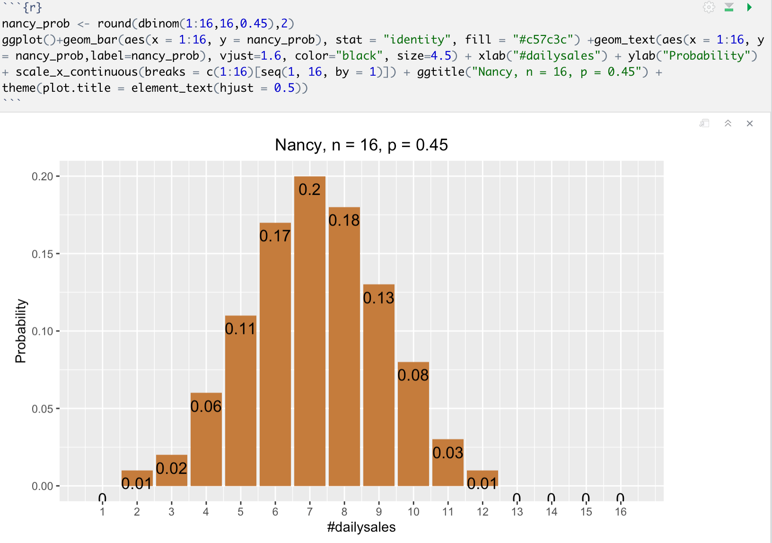
Binomial Distribution
Probability distribution graph for Nancy:

Slide 13
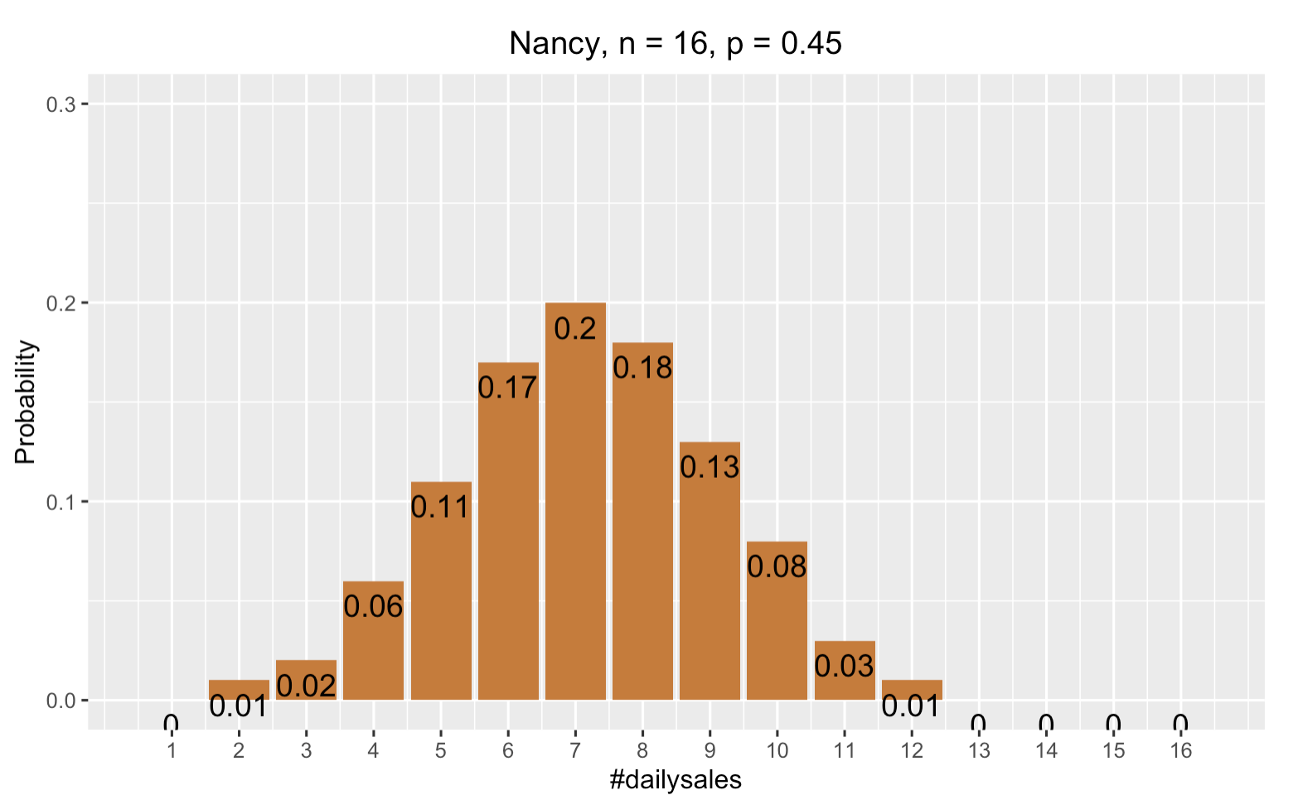
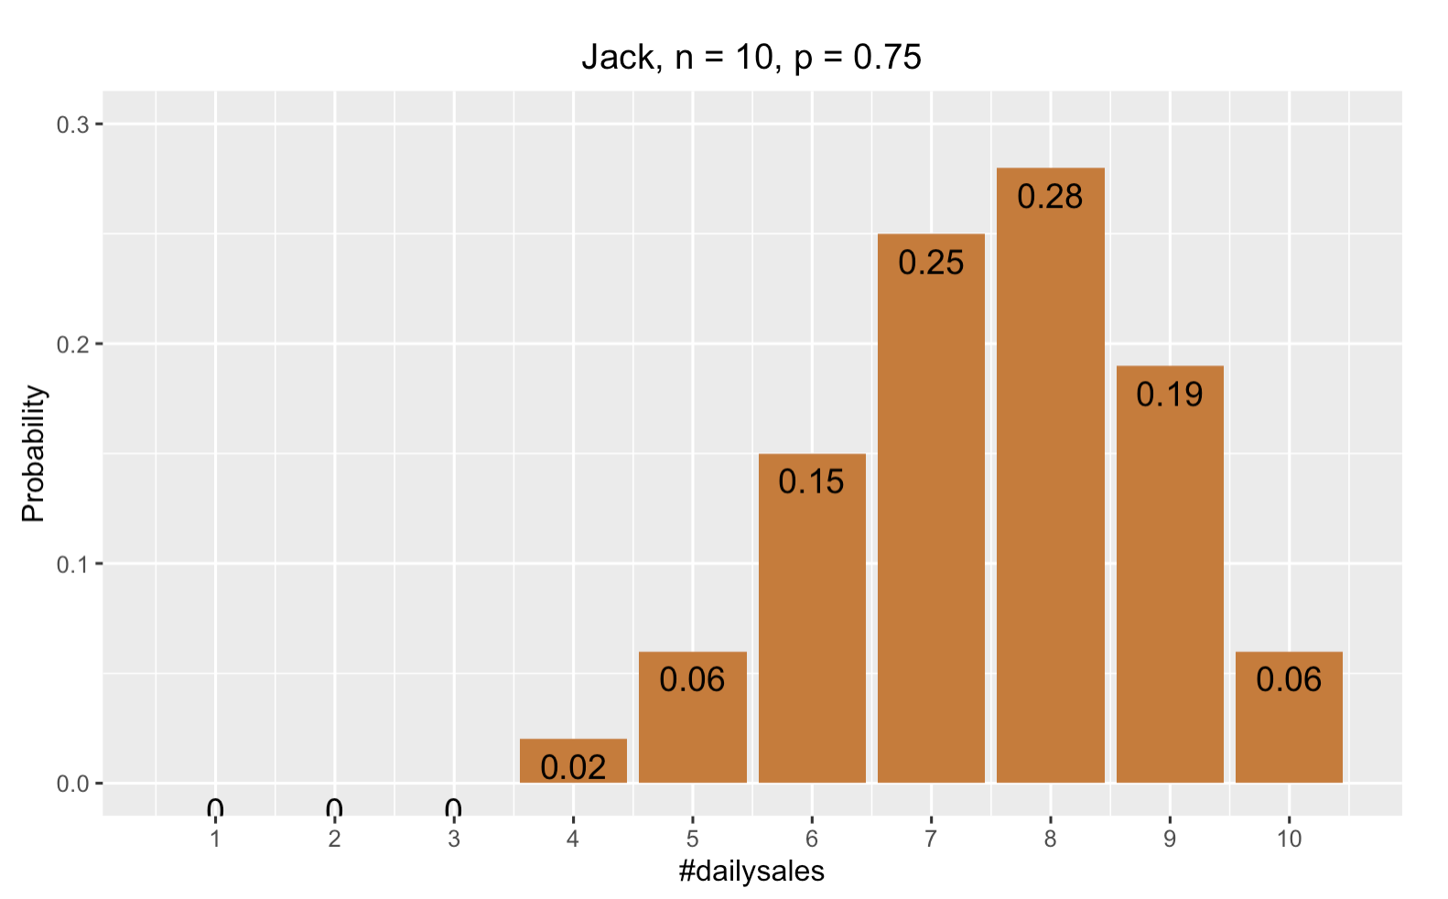
Binomial Distribution
Probability distribution graph comparison:

Slide 14
Binomial Distribution
Conclusion:
Even though Nancy has a lower success rate in terms of making a sales calls per day overcomes the lower success rate.
Therefore the greater probability of making 6 sales per day belongs to Nancy, even though Jack’s success rate is higher.
Lesson: Probability of any given outcomes a combination of both the number of trails and the success rate.

Slide 15
Binomial Distribution
Links:
https://www.math.unl.edu/~sdunbar1/ProbabilityTheory/Lessons/BernoulliTrials/BinomialDistribution/binomialdistribution.pdf
http://www.r-tutor.com/elementary-statistics/probability-distributions/binomial-distribution
http://pages.stat.wisc.edu/~larget/R/prob-R.pdf

Slide 16


